Slide 1
Educators Guide to Bloodstain Pattern Analysis: Real World Science!
Kathy Mirakovits
Portage Northern High School
kmirakovits@gmail.com
www.forensicscience-ed.com

Slide 2
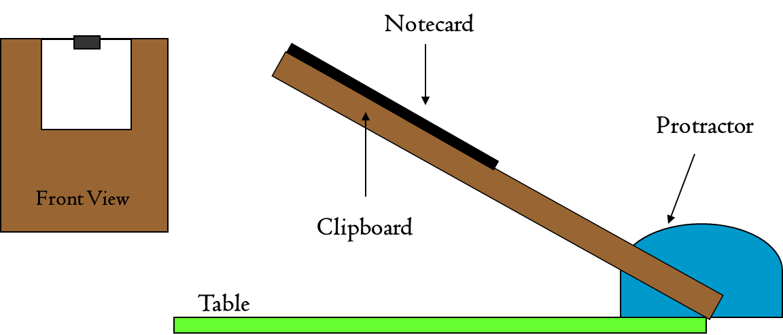
1st: Making Blood Drops
Materials: Calculator, Simulated Blood, Meterstick, 12” ruler/calipers, Notecards or paper. (10x Mini Loupe w/Reticle)
Vertical Drops
Heights: 20, 40, 60, 80, 100 (suggest more in your class)
How to keep the meterstick clean!
Angled Drops
Apparatus
Drip Angles
20⁰, 30⁰, 40⁰, 50⁰
Let them dry while
we talk analysis!
Important:
Ѳ_{B} + Ѳ_{C} = 90⁰
Ѳ_{B}
Ѳ_{C}

Slide 3
Physical Properties of Blood
Fairly high surface tension
Very viscous
Sticky-adheres to external surface
Moves as an oscillating sphere
https://www.ameslab.gov/mfrc/bpa_videos

Slide 4
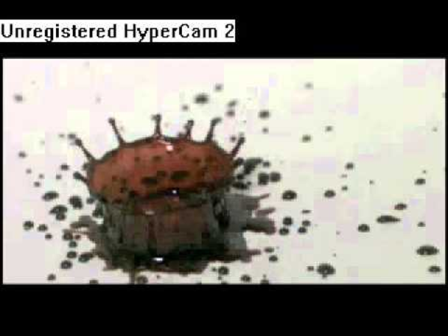
Blood Drops in Flight
Vertical Drops
90⁰ to the surface
Circular shape
Spines and Satellite Spatter
Graph: Height vs Diameter
10 cm drop
Spine
Satellite Spatter
100 cm drop

Slide 5
Blood in Flight
Angled Drops
Projectile path
Elliptical shape
Tails & satellites tell direction of origin

Slide 6
Measure your Bloodstains
Measuring Vertical Drops
Stains are circular
Measure diameter
Do not include spines
Parent Drop
Construct Data Table
Graph variables
Independent Variable (x axis)
Dependent Variable (y axis)
Line of Best Fit (LOBF)
What is the PURPOSE of graphing this data?

Slide 7
Analyzing the Flight of Angled Blood Drops
=
A
B
C
B
A
B
Droplet’s
Motion Vector
A
Ѳ
B
C

Slide 8
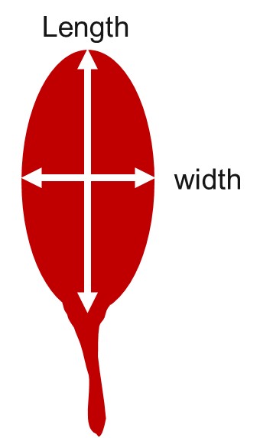
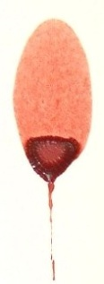
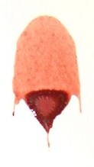
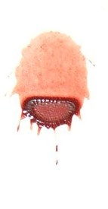
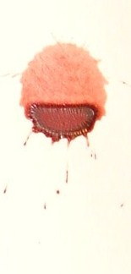
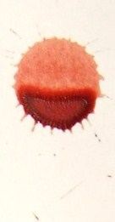
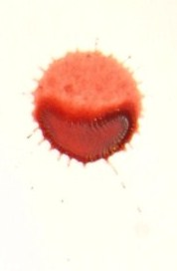
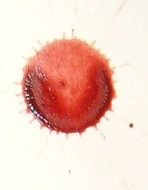
Measuring Angled Blood Drops: Calculating Angle of Impact
10⁰ 20⁰ 30⁰ 40⁰ 50⁰
60⁰ 70⁰ 80⁰ 90⁰

Slide 9
Impact Angle Analysis: The Cool Part!
Angled Drops
Calculating Impact Angles
Inverse Sine Formula
Based on shape of bloodstain
Practice Handout (for students)
Calculate YOUR Impact Angles ($+/−$ 5⁰)
Calculate selected stains on Bloodstain Sheet
Stringing Bloodstains
Right Angle Trigonometry
Based on path of bloodstain
Determines the Point of Origin of Blood
String Impact Spatter due to Blunt Force Trauma
Horizontal or Vertical Surfaces
A
Ѳ
B
C
Path of Blood Drop
Point of Origin
Ѳ
Contact Surface

Slide 10
Area of Convergence
point of convergence
area of convergence

Slide 11
Measure from front of blood drop to point of convergence = D
Use the tangent formula to find Point of Origin = P
P
Blood droplet
θ
From Point of Convergence
D

Slide 12
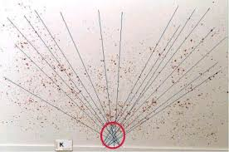
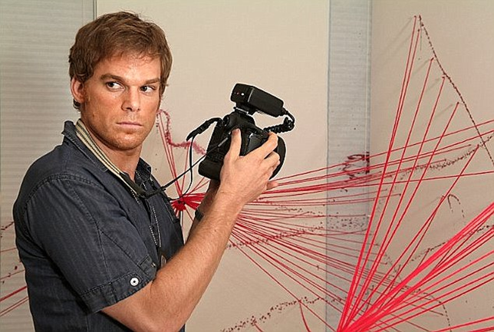
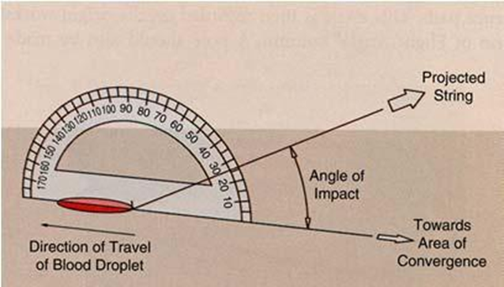

Slide 13
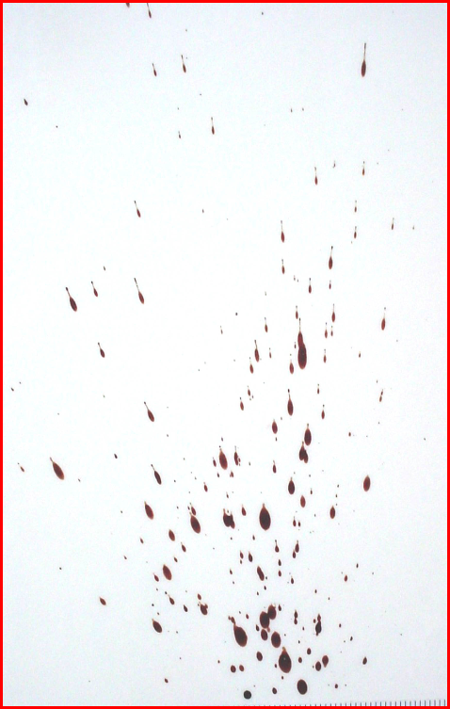
Impact Angles
1. 2/5 24⁰
2. 1.5/4 22⁰
1/3 20⁰
2/4.5 26⁰
5. 3/6 30⁰
2/4 30⁰
7. 1/4 14⁰
P = D (Tan Ѳ)
Point of Origin
4.9 cm
6.1 cm
5.3 cm
4.5 cm
4.2 cm
5.6 cm
5.1 cm
7
3
2
Tan θ = P/D
D (point to stain)
11 cm
15 cm
14.5 cm
9.3 cm
7.3 cm
9.7 cm
20.6 cm
4
6
5
1
Conclusion:
The source was 4.2 to 6.1 cm above the Point of Convergence
Point of Convergence

Slide 14
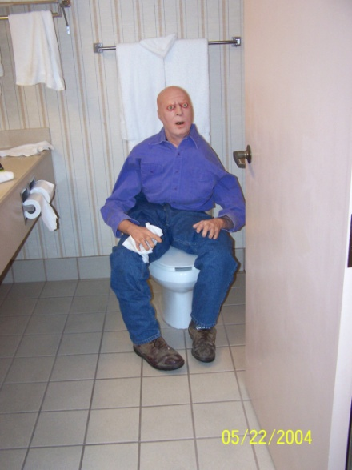
Questions? kmirakovits@gmail.com

Slide 15
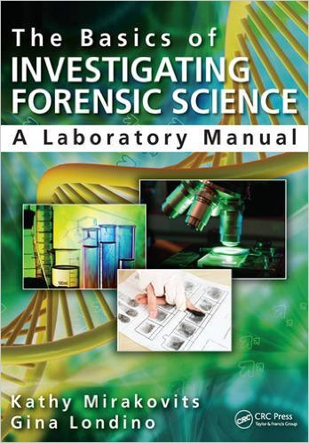
Supplies
Blood Spatter Kits from Wards Natural Science
Introduction to Blood Spatter Analysis: 366834
Advanced Techniques in Blood Spatter Analysis. 360053
Simulated Drip & Projected Blood (250 ml) 375312
Simulated Transfer Blood. 375311
Books/Publications
Forensic Science, The Basics, 3rd Edition; Siegel and Mirakovits
The Basics in Investigating Forensic Science, A Lab Manual; Mirakovits and Londino
Summer Workshops
www.forensicscience-ed.com

